Slide 1
Tree Terminology
Presented By S.R.Zameer

Slide 2
Tree Terminology
In linear data structure, data is organized in sequential order and in non-linear data structure, data is organized in random order. Tree is a very popular data structure used in wide range of applications. A tree data structure can be defined as follows...
Tree is a non-linear data structure which organizes data in hierarchical structure and this is a recursive definition.

Slide 3
Contd…
In tree data structure, every individual element is called as Node. Node in a tree data structure, stores the actual data of that particular element and link to next element in hierarchical structure. In a tree data structure, if we have N number of nodes then we can have a maximum of N-1 number of links.

Slide 4
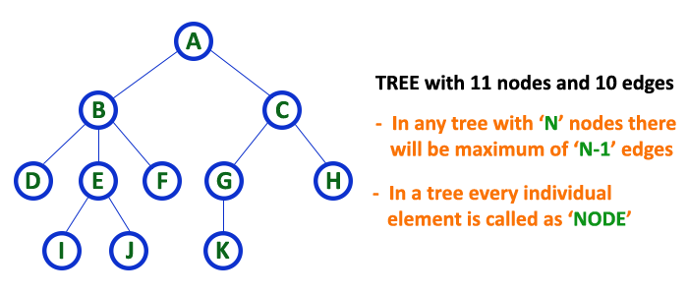
Example

